Slide 1
Ch4. Tree
Binary Search Tree

Slide 2
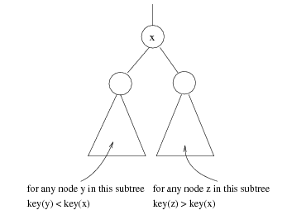
Binary Search Tree
（二叉排序树）
A binary search tree may be empty. If it is not empty, suppose every node has a key which is an integer, and the keys are distinct.
For EVERY node X
  All the keys in its left
  subtree are smaller
  than the key value in X
  All the keys in its right
  subtree are larger than
  the key value in X

Slide 3

30
60
20
5
40
70
15
25
2
65
80
12
21
26

Slide 4
ADT of BST
Objects: A finite ordered list with zero or more elements.
Operations:
☞ SearchTree MakeEmpty( SearchTree T );
☞ PtrToNode Search( int X, SearchTree T );
☞ PtrToNode FindMin( SearchTree T );
☞ PtrToNode FindMax( SearchTree T );
☞ SearchTree Insert( int X, SearchTree T );
☞ SearchTree Delete( int X, SearchTree T );
☞ int Retrieve( Position P );

Slide 5
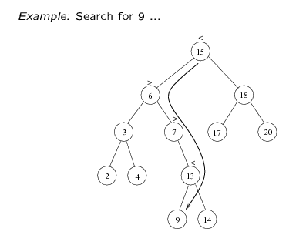
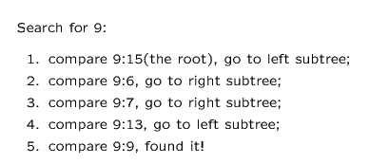
Searching BST

Slide 6
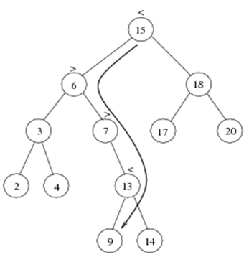
PtrToNode Search( int X, SearchTree T )
{
if ( T == NULL )
return NULL; /* not found in an empty tree */
if ( X < T->Data ) /* if smaller than root */
return Search( X, T->Left ); /* search left subtree */
else
if ( X > T->Data ) /* if larger than root */
return Search( X, T->Right ); /* search right subtree */
else /* if X == root */
return T; /* found */
}
T( N ) = S ( N ) =
O( h ) where h is the depth of X

Slide 7
PtrToNode Iter_Find( int X, SearchTree T )
{
/* iterative version of Find */
while ( T ) {
if ( X == T->Data )
return T ; /* found */
if ( X < T->Data )
T = T->Left ; /*move down along left path */
else
T = T-> Right ; /* move down along right path */
} /* end while-loop */
return NULL ; /* not found */
}

Slide 8
Find Min/ Find Max
Goal: return the node containing the smallest (largest) key in the tree
Algorithm: Start at the root and go left (right) as long as there is a left (right) child. The stopping point is the smallest (largest) element

Slide 9

主观题
答案解析
10分
答案解析
Fill the blank to make the program completed:
PtrToNode FindMax( SearchTree T )
{
if ( T != NULL )
while ( )
T = T->Right;
return T
}
T->Right != NULL
正常使用主观题需2.0以上版本雨课堂
作答
可为此题添加文本、图片、公式等解析，且需将内容全部放在本区域内。正常使用需3.0以上版本

Slide 10
主观题
答案解析
10分
答案解析
PtrToNode FindMax( SearchTree T )
{
if ( T == NULL )
return NULL;
else
if ( )
return T;
else
return FindMax( T->Right );
}
T->Right==NULL
正常使用主观题需2.0以上版本雨课堂
作答
可为此题添加文本、图片、公式等解析，且需将内容全部放在本区域内。正常使用需3.0以上版本

Slide 11
PtrToNode FindMax( SearchTree T )
{
if ( T != NULL )
while ( T->Right != NULL )
T = T->Right; /* keep moving to find right most */
return T; /* return NULL or the right most */
}
T( N ) = O ( h )
PtrToNode FindMax( SearchTree T )
{
if ( T == NULL )
return NULL; /* not found in an empty tree */
else
if ( T->Right == NULL ) return T; /* found right most */
else return FindMax( T->Right ); /* keep moving to left */
}
T( N ) = O ( h )

Slide 12
Insertion
Insert 80
30
① check if 80 is already in the tree
5
40
② 80 > 40, so it must be the right child of 40
2
25
35
80
This is the last node
we encounter
when search for the key.
It will be the parent
of the new node.
Insert 35
① check if 35 is already in the tree
② 35 < 40, so it must be the left child of 40
Insert 25
① check if 25 is already in the tree
② 25 > 5, so it must be the right child of 5

Slide 13
Proceed down the tree as you do with a search.
If X is found, do nothing.
Otherwise, insert X at the last spot on the path traversed.

Slide 14
单选题
1分
The inorder traversal sequence of a BST is a sorted sequence.
A
True
B
False
提交

Slide 15
单选题
1分
While inserting a new node into a BST, it will
always be inserted as a leaf node.
A
True
B
False
提交

Slide 16
SearchTree Insert( ElementType X, SearchTree T )
{
if ( T == NULL ) { /* Create and return a one-node tree */
T = (TreeNode *)malloc( sizeof( struct TreeNode ) );
if ( T == NULL )
FatalError( "Out of space!!!" );
else {
T->Data = X;
T->Left = T->Right = NULL; }
} /* End creating a one-node tree */
else /* If there is a tree */
if ( X < T->Data)
T->Left = Insert( X, T->Left );
else
if ( X > T->Data )
T->Right = Insert( X, T->Right );
/* Else X is in the tree already; we'll do nothing */
return T; /* Do not forget this line!! */
}
T( N ) = O ( h )

Slide 17
Deletion
There should be no gap after deletion.
The property of search tree should be maintained.
20
15
25
12
18
26

Slide 18
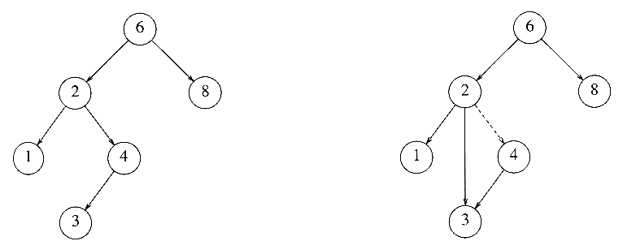
Different Cases
Case 1: the node is a leaf
  Delete it immediately by reset its parent link to NULL
Case 2: the node has one child
  Adjust the link from the parent to bypass that node

Slide 19
Deletion Case 3
Note: These kinds of nodes
have degree at most 1.
Case 3: the node has 2 children
  Replace the key of that node with the smallest one in its right subtree (or the largest one in its left subtree)
  Delete that replacing node from the subtree
Time complexity = O(height of the tree)
〖Example〗 Delete 60
40
20
55
Solution 1: reset left subtree.
60
10
30
50
70
Solution 2: reset right subtree.
45
55
52
52
8/22

Slide 20
SearchTree Delete( ElementType X, SearchTree T )
{ Position TmpCell;
if ( T == NULL ) Error( "Element not found" );
else if ( X < T->Data ) /* Go left */
T->Left = Delete( X, T->Left );
else if ( X > T->Data ) /* Go right */
T->Right = Delete( X, T->Right );
else /* Found element to be deleted */
if ( T->Left && T->Right ) { /* Two children */
/* Replace with smallest in right subtree */
TmpCell = FindMin( T->Right );
T->Data = TmpCell->Data;
T->Right = Delete( T->Data, T->Right ); } /* End if */
else { /* One or zero child */
TmpCell = T;
if ( T->Left == NULL ) /* Also handles 0 child */
T = T->Right;
else if ( T->Right == NULL ) T = T->Left;
free( TmpCell ); } /* End else 1 or 0 child */
return T;
}
40
T1
20
60
10
30
50
70
45
55
52
T( N ) = O ( h ) where h is the height of the tree

Slide 21
Operations:
  ☞ PtrToNode Search( int X, SearchTree T );
  ☞ PtrToNode FindMin( SearchTree T );
  ☞ PtrToNode FindMax( SearchTree T );
  ☞ SearchTree Insert( int X, SearchTree T );
  ☞ SearchTree Delete( int X, SearchTree T );
The time complexity of all these operations are:
T( N ) = O ( h ) , where h is the height of the BST

Slide 22
Question: Insert n elements into an original empty binary search tree. How high can this tree be?
Answer: The height depends on the order of insertion.
〖Example〗 Given elements 1, 2, 3, 4, 5, 6, 7. Insert them into an originally empty BST one by one in the orders:
4, 2, 1, 3, 6, 5, 7 and 1, 2, 3, 4, 5, 6, 7
1
4
2
2
6
3
h = 6
4
1
3
5
7
5
h = 2
6
In the best case: height of the tree= ?
In the worst case: height of the tree= ?
7

